Slide 1
DevResources
Ryan Hardin, Johnny Hinton, and Jerry Phan

Slide 2
Dev Resources Background
A platform that provides developers a community to share ideas and resources with each other.

Slide 3
Background Cont’d
The platform will also welcome users who are new to development, as it can be difficult to find the correct resources when you are a beginner.

Slide 4
Frameworks/Technologies
The Front End is built with Angular 6 and Node.js and will use Apollo Client to make GraphQL queries.
Express along with Apollo for a GraphQL implementation on the back end used to build the API
MongoDB (using mlab) for our database

Slide 5
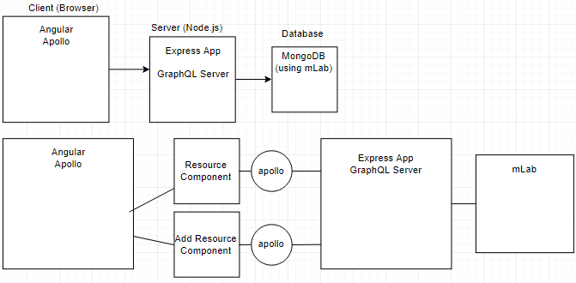



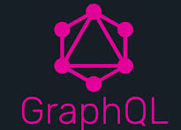

Flow Diagram

Slide 6
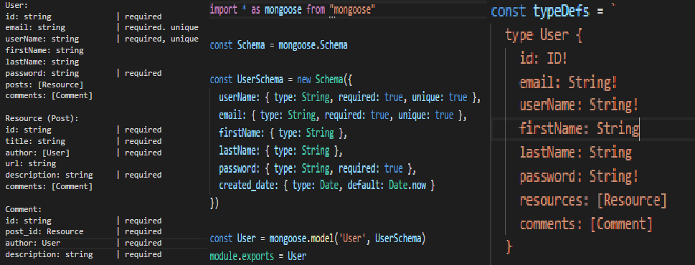
Design of data Model

Slide 7
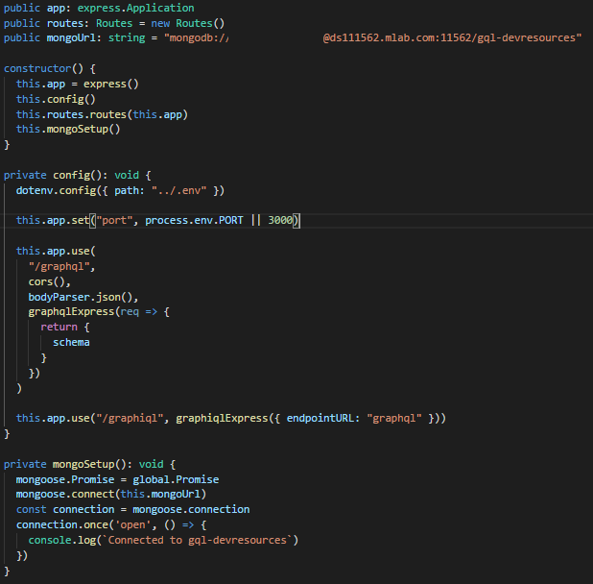

Path & Routes

Slide 8
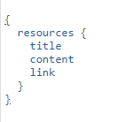
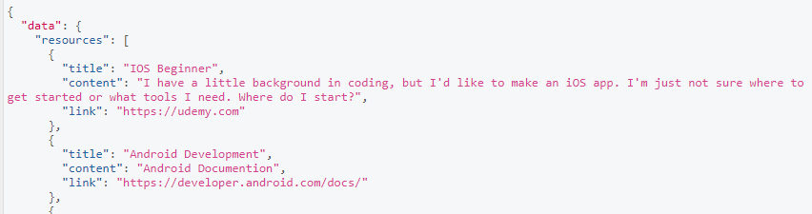
API
GraphQL:
One Endpoint
Multiple Requests, Full Response

Slide 9
Difficulties and Limitations
Compile issues
Learning GraphQl
Finding time to meet
Issues with git
Implementing a search function

Slide 10
Potential future direction
Implement a search feature
Categories
More time spent on the layout
Better organization of resources

